Slide 1
FAKE NEWS DETECTION
Sanchit Kumar
Alekya Karicherla

Slide 2
WHAT IS FAKE NEWS?
Fake news is false, made-up information which is circulated as real news.
Fake news is not a recent one.
But in Recent days it increased a lot due to social media where anyone can create , modify and spread the news.

Slide 3
PROBLEM STATEMENT
With the wide spread of fake news results in Negative influence over people.
Political events
Racism
GOAL
To reduce the impact of fake news, it is important to identify and filter it out from reaching the public, for the well-being of society.
We use different algorithms to detect, collect and filter the fake news from being wide-spread.

Slide 4
STEPS Involved
Selection of data set
Preprocessing
Feature Extraction
Model Selection
Classifier

Slide 5

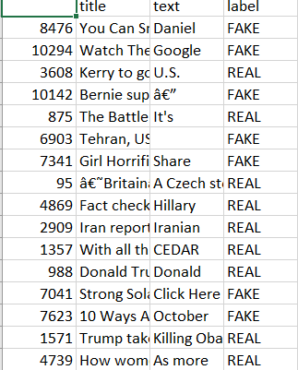
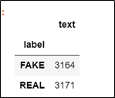
DATA SET
The data set being used is downloaded from Kaggle.
It contains the following headers:
Id
Title
Text
Label

Slide 6
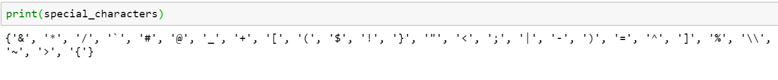
DATA Pre-processing
Pre-processing involves
Removal of special characters
Removal of punctuation marks
Spell checking
Stemming words
Removal of stop words
Special Characters and Punctuation marks

Slide 7
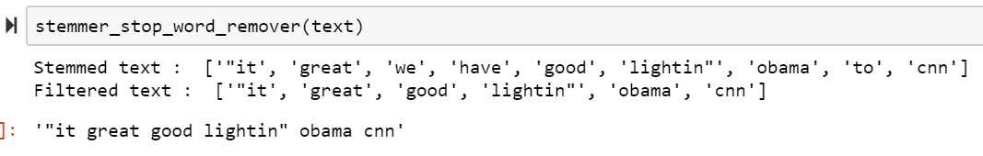
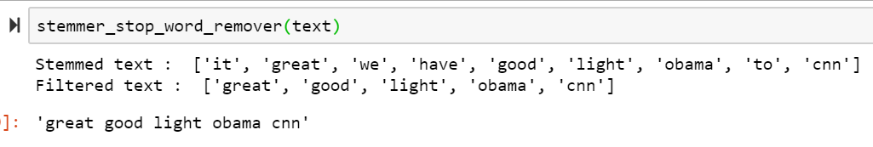
SPELL Checking
Before spell-checking
After spell-checking

Slide 8
Feature extraction
The pre-processed data is transformed into set of features.
Vectorization is the process of turning a collection of data into numerical feature vectors.
Features derived are
Count Vectorizer
TF-IDF Vectorizer
Hash Vectorizer
N-grams: Sequence of N-words is also used in-order to specify the word sequence in Count vectorizer and TF-IDF Vectorizer.

Slide 9
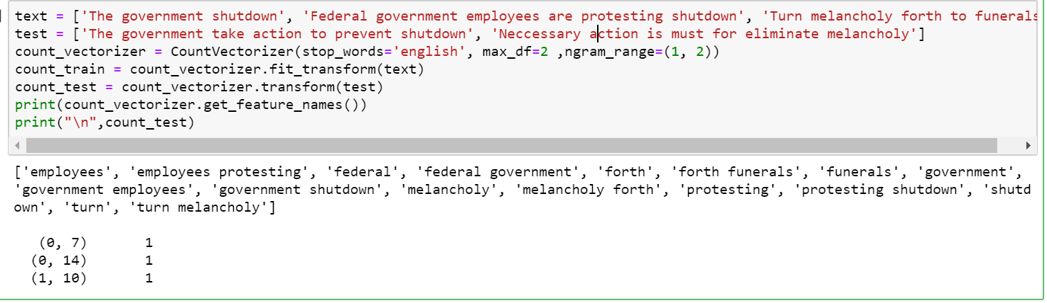
COUNT VECTORIZER
Converts text to word count vectors.
Builds a vocabulary of known words with the given data-set.

Slide 10
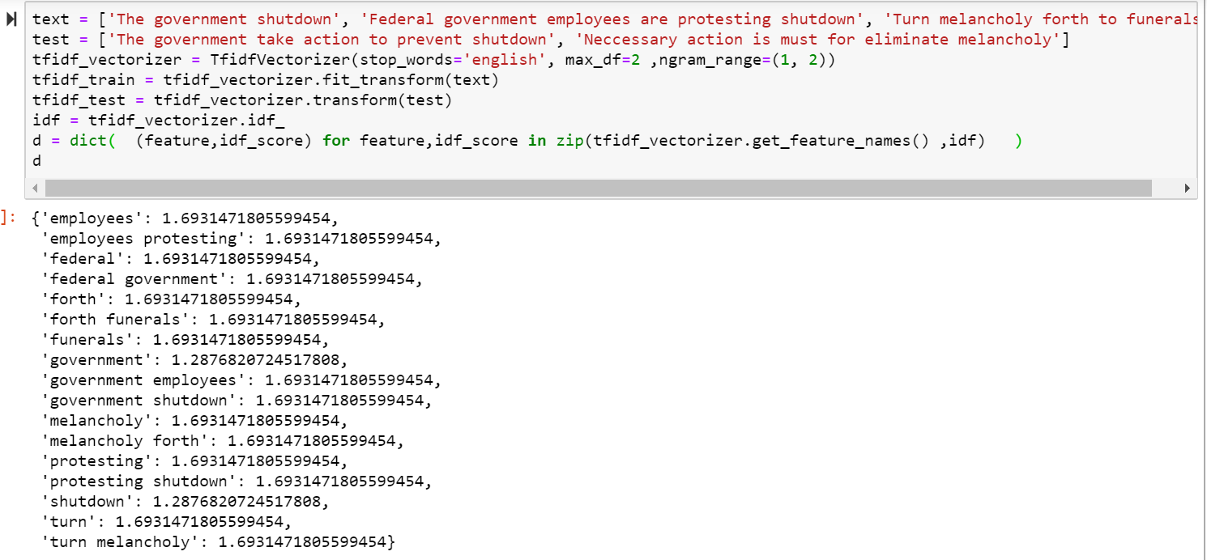

TF-IDF VECTORIZER
To calculate word frequencies, and by far the most popular method is called TF-IDF(Term Frequency – Inverse Document).
Term Frequency: This summarizes how often a given word appears within a document.
Inverse Document Frequency: This downscales words that appear a lot across documents.

Slide 11
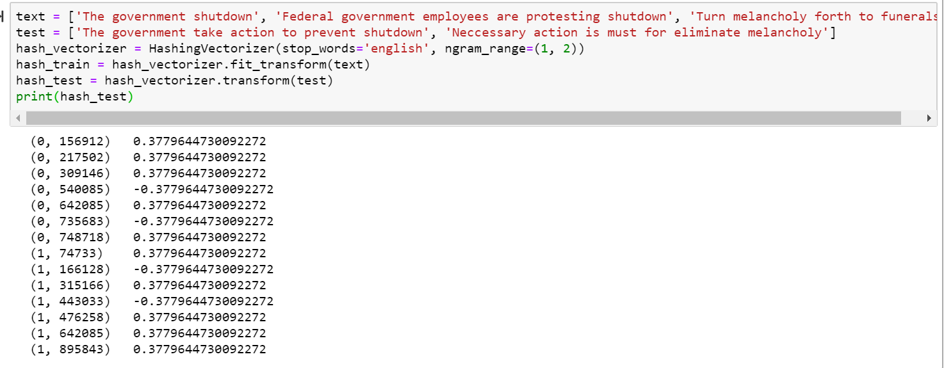
HASHING VECTORIZER
One limitation with the other two vectorizers is that the vocabulary can become very large.
To reduce that, we use hash of words to convert them to integers.
Instead of storing the tokens as strings, the vectorizer applies the hashing trick to encode them as numerical indexes.
The downside of this method is that once vectorized, the features’ names can no longer be retrieved.

Slide 12
Model selection
Classifiers separates observations into groups based on their characteristics.
For data classification, the following three classifiers are used.
Multinomial Naïve-Bayes
SVM
Passive Aggressive

Slide 13
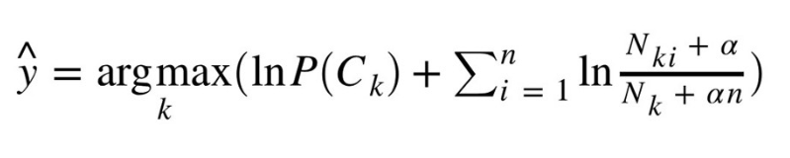
Multinomial Naïve-Bayes Classifier
This is mostly used for document classification problem, i.e whether a document belongs to the category of sports, politics, technology etc. The features/predictors used by the classifier are the frequency of the words present in the document.

Slide 14
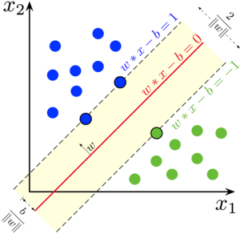
SVM Classifier
Supervised Machine learning algorithm
each data item is plotted as a point in n-dimensional space (where n is number of features you have) with the value of each feature being the value of a particular coordinate.
Using linear Kernel, which is best suited for text classification and computationally very cheap.

Slide 15
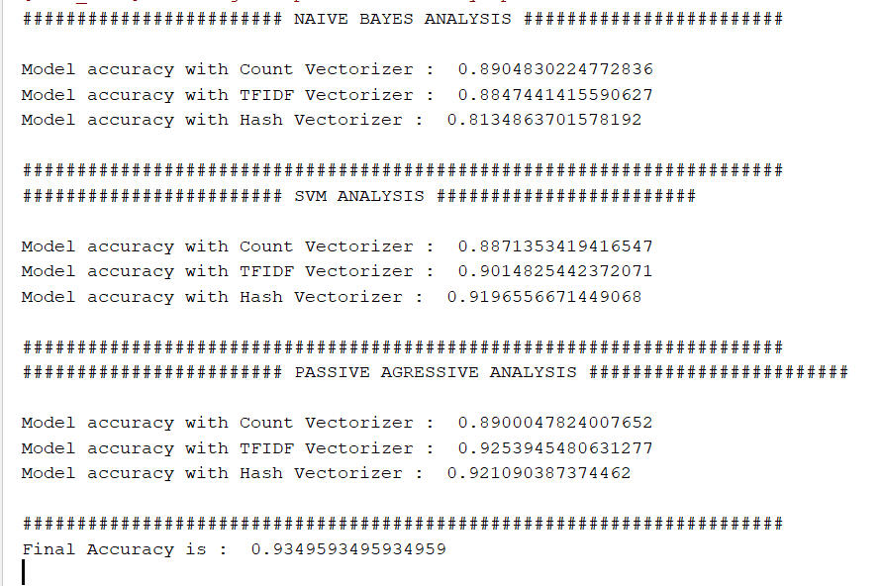
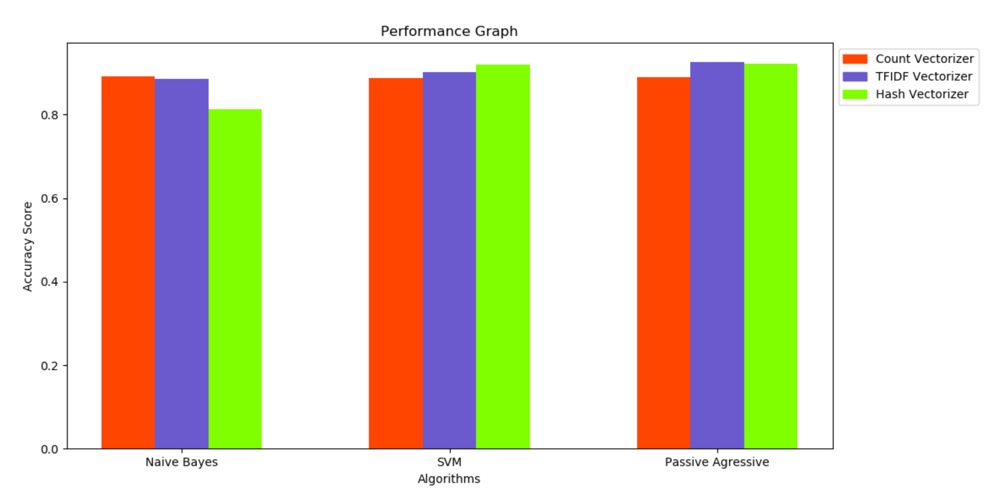
results

Slide 16
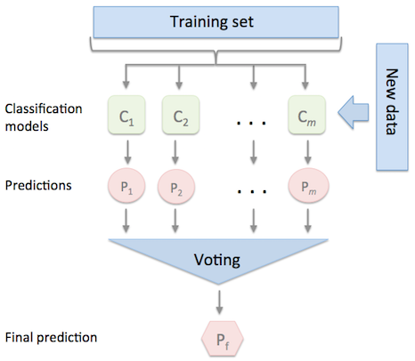
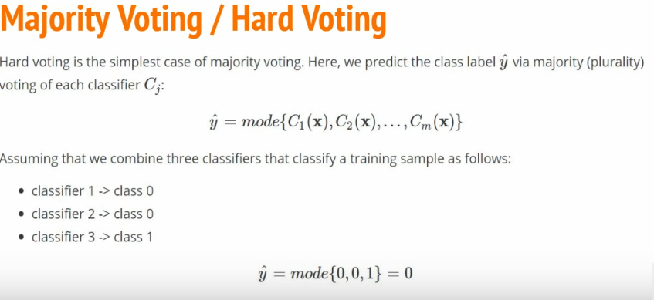
MAX Voting classifier
We are using sklearn inbuild VotingClassifier.
Hard/Majority voting is used for the classification.

Slide 17
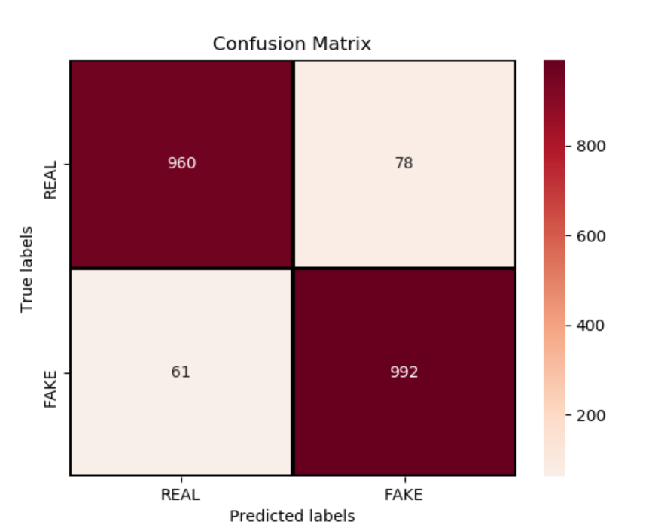
Final results

